Slide 1

VALLURUPALLI NAGESWARA RAO VIGNANA JYOTHI INSTITUTE OF ENGINEERING AND TECHNOLOGY
Department of Computer Science and Engineering
Introduction
MACHINE LEARNING
Regulation: A19
BTech CSE (III Year-II Sem)
Kriti Ohri
Assistant Professor
Department of Computer Science and Engineering

Slide 2
Introduction To Machine Learning

Slide 3
Different Motivations for Studying Machine Learning
There are several different motivations or approaches we take when are studying ML. While the following bullet points attempt an overall categorization, there are many exceptions:
Engineers: focusing on developing systems with high predictive performance for realworld problem solving
Mathematicians, computer scientists, and statisticians: understanding properties of predictive models and modeling approaches
Neuroscientists: understanding and modeling how a brain and intelligence works

Slide 4
Learning??
Learning is the ability to improve one’s behavior with experience. So, in case of machine learning its about building computer systems, that automatically improve with experience.
Machine learning explores algorithms that learn from data, build models from data and this model can be used for different tasks. For example, model can be used for prediction, decision making or solving tasks.
Notes:
The acquisition of knowledge or skills through study, experience, or being taught.

Slide 5


Learning??

Slide 6
Intelligence
What is intelligence?
It can be defined as the ability to comprehend; to understand and profit from experience
Capability to acquire and apply knowledge
Notes:
the ability to acquire and apply knowledge and skills.
to comprehend; to understand and profit from experience

Slide 7
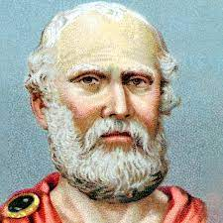
Plato’s Theory of Learning
Plato
The concept of abstract ideas are known to us apriori, through a mystic connection with world.
He concluded that ability to think is found in a priori knowledge of the concepts.
Notes:
The Socratic philosophers in ancient Greece were Socrates, Plato, and Aristotle. These are some of the most well-known of all Greek philosophers. Socrates (470/469–399 B.C.E.) is remembered for his teaching methods and for asking thought-provoking questions

Slide 8
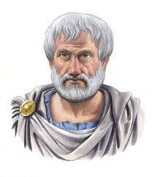
Aristotle’s Theory on Learning
Aristotle
Criticized his teachers theory, as its not taking into account the important aspect:
An ability to learn or adapt to changing world.
Notes:
The Socratic philosophers in ancient Greece were Socrates, Plato, and Aristotle. These are some of the most well-known of all Greek philosophers. Socrates (470/469–399 B.C.E.) is remembered for his teaching methods and for asking thought-provoking questions

Slide 9
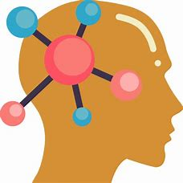
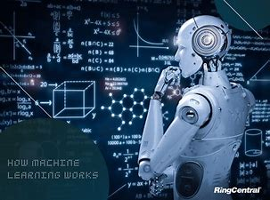
Human intellect → machines
Intellectual Capability
Human
Machine
Notes:
“Intellectual ability” is exceptional capability or potential recognized through cognitive processes (e.g., memory, reasoning, rate of learning, spatial reasoning, ability to find and solve problems, ability to manipulate abstract ideas and make connections, etc.). [

Slide 10
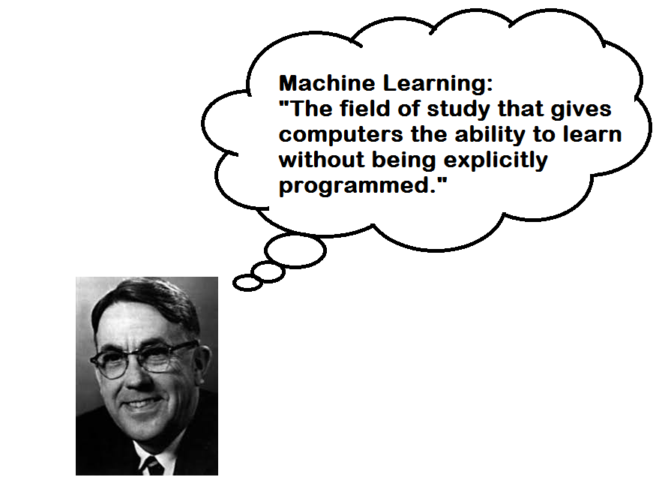
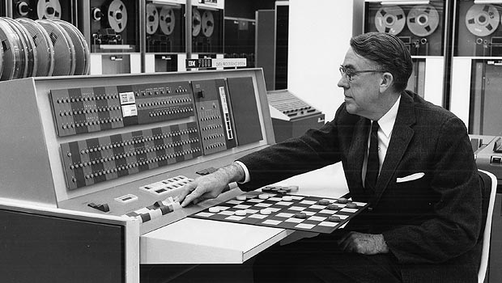
History of Machine Learning
Machine learning is the field of study that gives computers the ability to learn
without being explicitly programmed. 2 — Arthur L. Samuel, AI pioneer, 1959
Samuel, A.L., 2000. Some studies in machine learning using the game of checkers. IBM Journal of research and development, 44(1.2), pp.206-226.
Notes:
Arthur Lee Samuel was an American pioneer in the field of computer gaming and artificial intelligence. He popularized the term "machine learning" in 1959.

Slide 11
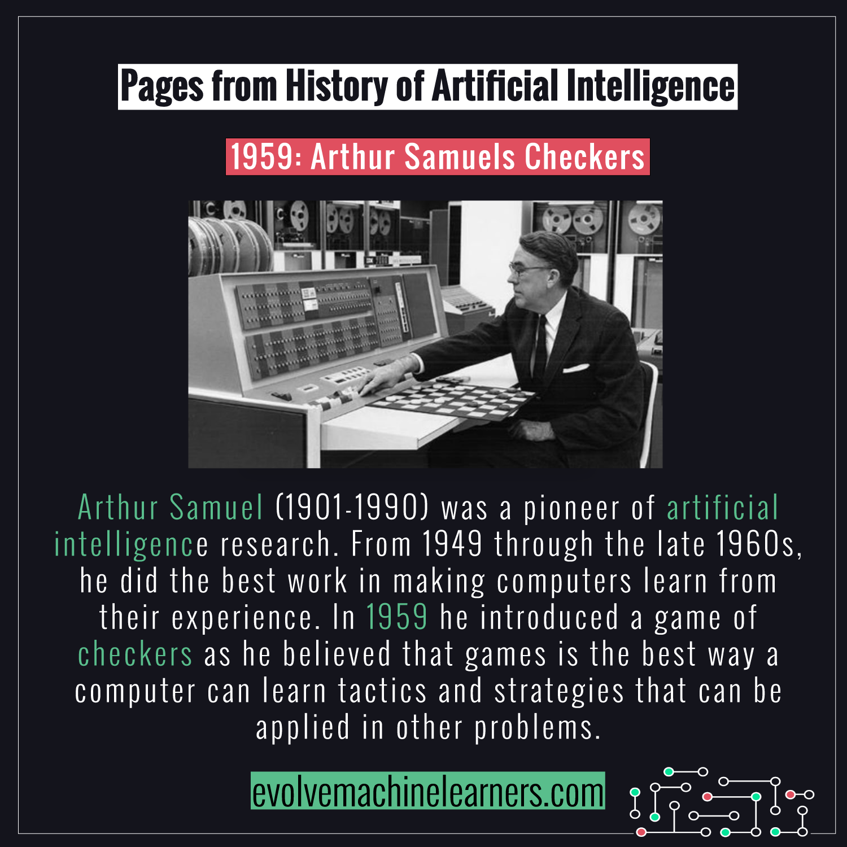

Slide 12
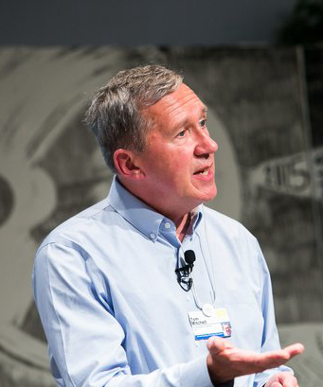
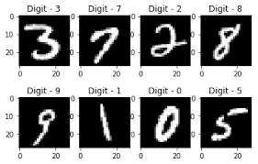
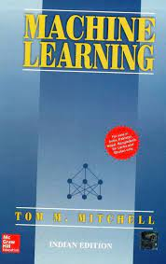
Machine Learning
A computer program is said to learn from experience E with respect to some class of tasks T and performance measure P, if its performance at tasks in T, as measured by P, improves with experience E.
— Tom Mitchell, Machine Learning Professor at Carnegie Mellon University
Task T: ?
Performance measure P: ?
Training Experience: E ?
Notes:
Tom Michael Mitchell is an American computer scientist and E. Fredkin University Professor at the Carnegie Mellon Unive
Makes some sense of data->data in abundance, ml algos to change data into knowledge, libraries, patterns, and make predictions

Slide 13
In simple terms, Machine learning is a subset of Artificial Intelligence (AI) which provides machines the ability to learn automatically & improve from experience without being explicitly programmed to do so. In the sense, it is the practice of getting Machines to solve problems by gaining the ability to think.
But wait, can a machine think or make decisions? Well, if you feed a machine a good amount of data, it will learn how to interpret, process and analyze this data by using Machine Learning Algorithms, in order to solve real-world problems.

Slide 14
Need For Machine Learning
Ever since the technical revolution, we’ve been generating an immeasurable amount of data. As per research, we generate around 2.5 quintillion bytes of data every single day!
With the availability of so much data, it is finally possible to build predictive models that can study and analyze complex data to find useful insights and deliver more accurate results.
Top Tier companies such as Netflix and Amazon build such Machine Learning models by using tons of data in order to identify profitable opportunities and avoid unwanted risks.

Slide 15
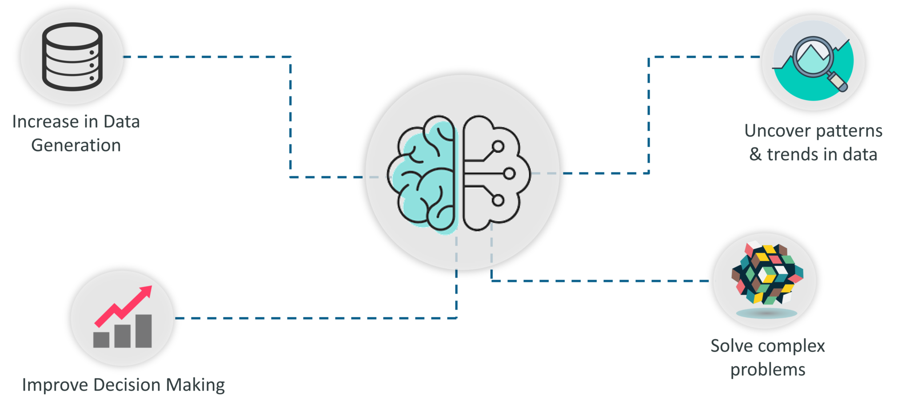
List of reasons why Machine Learning is so important
https://www.edureka.co/blog/introduction-to-machine-learning/

Slide 16
Why Machine Learning is so important:
Increase in Data Generation: Due to excessive production of data, we need a method that can be used to structure, analyze and draw useful insights from data. This is where Machine Learning comes in. It uses data to solve problems and find solutions to the most complex tasks faced by organizations.
Improve Decision Making: By making use of various algorithms, Machine Learning can be used to make better business decisions. For example, Machine Learning is used to forecast sales, predict downfalls in the stock market, identify risks and anomalies, etc.

Slide 17
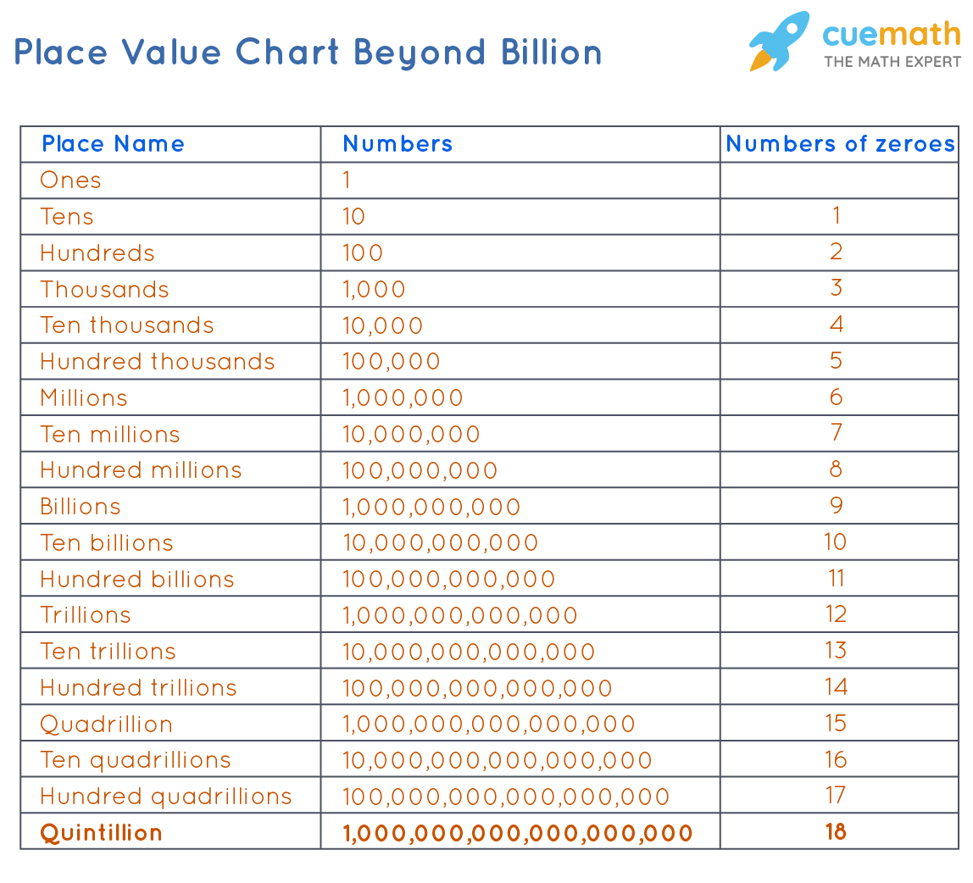

Slide 18
Uncover patterns & trends in data: Finding hidden patterns and extracting key insights from data is the most essential part of Machine Learning. By building predictive models and using statistical techniques, Machine Learning allows you to dig beneath the surface and explore the data at a minute scale. Understanding data and extracting patterns manually will take days, whereas Machine Learning algorithms can perform such computations in less than a second.
Solve complex problems: From detecting the genes linked to the deadly ALS disease to building self-driving cars, Machine Learning can be used to solve the most complex problems.

Slide 19
How machine learning differs from programmatic solution
Traditional Programming
Machine Learning
Data
Computer
Output
Program
Data
Computer
Program or a model
Output
Notes:
Instead of having humans to manually build rules and build models from analysing large amounts of data, machine learning offers a more efficient alternative for capturing the knowledge in data to gradually improve the performance of predictive models and make data driven decisions.

Slide 20
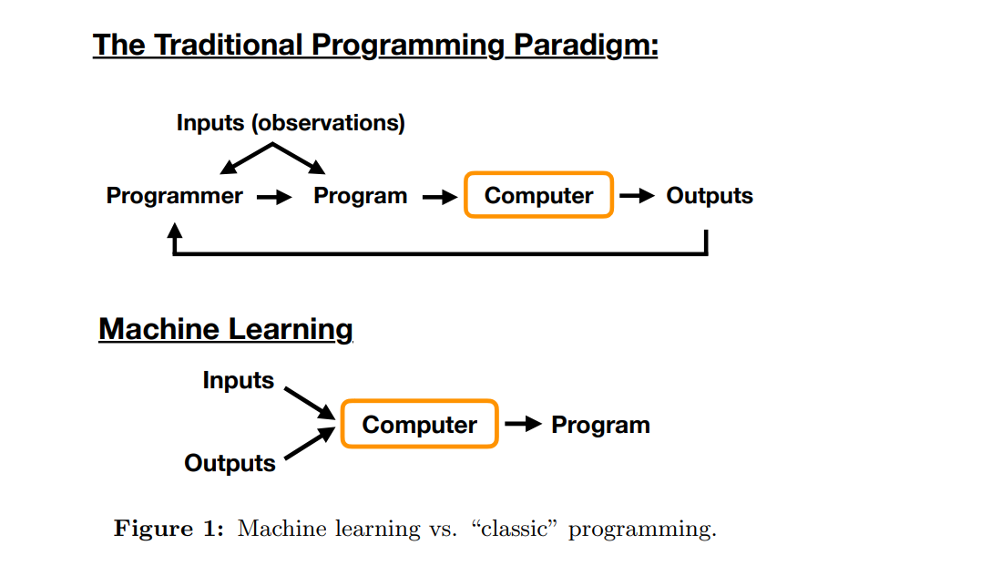

Slide 21
Schematic Diagram of Learning System
Experiences / data
Problem / task
Learner
Model
Reasoner
Background knowledge / Bias
Performance / Answer
Machine Learning- Sudeshna Sarkar, NPTEL

Slide 22
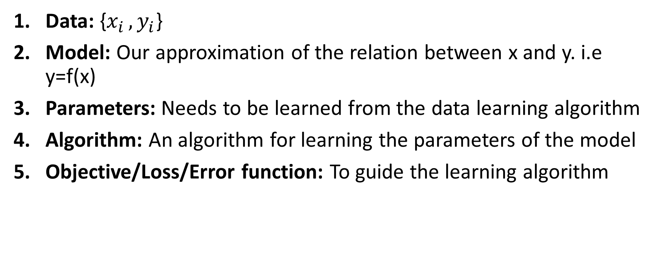
This brings us to a typical machine learning setup which has the following components
Data: {$x_{i }, y_{i}$}
Model: Our approximation of the relation between x and y. i.e y=f(x)
Parameters: Needs to be learned from the data learning algorithm
Algorithm: An algorithm for learning the parameters of the model
Objective/Loss/Error function: To guide the learning algorithm
Input
function
output

Slide 23
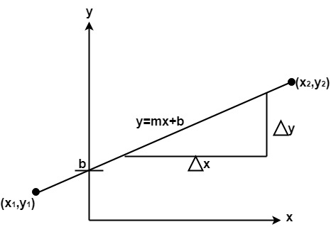
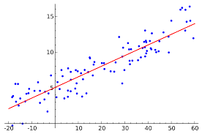
Parameters
What are the parameters of a linear regression? A. Linear regression has two main parameters: slope (weight) and intercept. The slope represents the change in the dependent variable for a unit change in the independent variable. The intercept is the value of the dependent variable when the independent variable is zero.

Slide 24
Terms used in Machine Learning
Algorithm: A Machine Learning algorithm is a set of rules and statistical techniques used to learn patterns from data and draw significant information from it. It is the logic behind a Machine Learning model. An example of a Machine Learning algorithm is the Linear Regression algorithm.
Model: A model is the main component of Machine Learning. A model is trained by using a Machine Learning Algorithm. An algorithm maps all the decisions that a model is supposed to take based on the given input, in order to get the correct output.
Notes:
Machine Learning algorithms are the programs that can learn the hidden patterns from the data, predict the output, and improve the performance from experiences on their own. Different algorithms can be used in machine learning for different tasks, such as simple linear regression that can be used for prediction problems like stock market prediction, and the KNN algorithm can be used for classification problems.

Slide 25
Terms used in Machine Learning
Predictor Variable/independent variable: It is a feature(s) of the data that can be used to predict the output.
Response Variable/dependent variable: It is the feature or the output variable that needs to be predicted by using the predictor variable(s).
Training Data: The Machine Learning model is built using the training data. The training data helps the model to identify key trends and patterns essential to predict the output.
Testing Data: After the model is trained, it must be tested to evaluate how accurately it can predict an outcome. This is done by the testing data set.

Slide 26
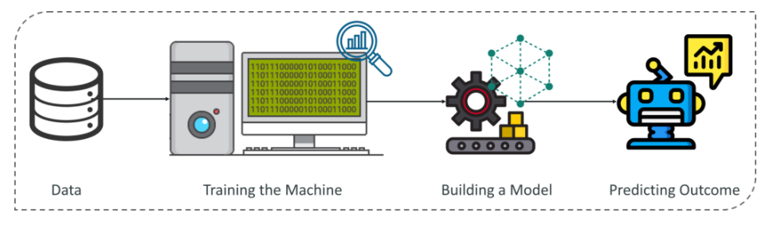
General Pipeline of a machine learning model
Machine Learning process begins by feeding the machine lots of data, by using this data the machine is trained to detect hidden insights and trends. These insights are then used to build a Machine Learning Model by using an algorithm in order to solve a problem.

Slide 27
Machine Learning Process
The Machine Learning process involves building a Predictive model that can be used to find a solution for a Problem Statement. To understand the Machine Learning process let’s assume that you have been given a problem that needs to be solved by using Machine Learning.

Slide 28
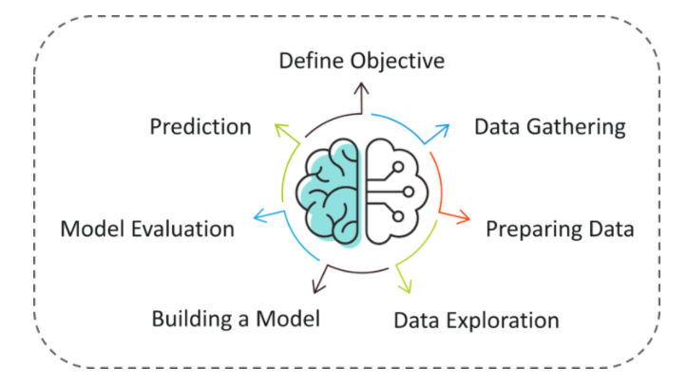
Machine Learning Process
https://www.edureka.co/blog/introduction-to-machine-learning/

Slide 29
The problem is to predict the occurrence of rain in your local area by using Machine Learning.
The below steps are followed in a Machine Learning process:
Step 1: Define the objective of the Problem Statement
At this step, we must understand what exactly needs to be predicted. In our case, the objective is to predict the possibility of rain by studying weather conditions. At this stage, it is also essential to take mental notes on what kind of data can be used to solve this problem or the type of approach you must follow to get to the solution.

Slide 30
Step 2: Data Gathering
At this stage, you must be asking questions such as,
What kind of data is needed to solve this problem?
Is the data available?
How can I get the data?
Coming back to the problem at hand, the data needed for weather forecasting includes measures such as humidity level, temperature, pressure, locality, whether or not you live in a hill station, etc. Such data must be collected and stored for analysis.

Slide 31
Step 3: Data Preparation
The data you collected is almost never in the right format. You will encounter a lot of inconsistencies in the data set such as missing values, redundant variables, duplicate values, etc. Removing such inconsistencies is very essential because they might lead to wrongful computations and predictions. Therefore, at this stage, you scan the data set for any inconsistencies and you fix them then and there.
Step 4: Exploratory Data Analysis
Grab your detective glasses because this stage is all about diving deep into data and finding all the hidden data mysteries. EDA or Exploratory Data Analysis is the brainstorming stage of Machine Learning. Data Exploration involves understanding the patterns and trends in the data. At this stage, all the useful insights are drawn and correlations between the variables are understood.
For example, in the case of predicting rainfall, we know that there is a strong possibility of rain if the temperature has fallen low. Such correlations must be understood and mapped at this stage.

Slide 32
Step 5: Building a Machine Learning Model
All the insights and patterns derived during Data Exploration are used to build the Machine Learning Model. This stage always begins by splitting the data set into two parts, training data, and testing data. The training data will be used to build and analyze the model. The logic of the model is based on the Machine Learning Algorithm that is being implemented.
In the case of predicting rainfall, since the output will be in the form of True (if it will rain tomorrow) or False (no rain tomorrow), we can use a Classification Algorithm such as Logistic Regression.
Choosing the right algorithm depends on the type of problem you’re trying to solve, the data set and the level of complexity of the problem.

Slide 33
Step 6: Model Evaluation & Optimization
After building a model by using the training data set, it is finally time to put the model to a test. The testing data set is used to check the efficiency of the model and how accurately it can predict the outcome. Once the accuracy is calculated, any further improvements in the model can be implemented at this stage. Methods like parameter tuning and cross-validation can be used to improve the performance of the model.
Step 7: Predictions
Once the model is evaluated and improved, it is finally used to make predictions. The final output can be a Categorical variable (eg. True or False) or it can be a Continuous Quantity (eg. the predicted value of a stock).
In our case, for predicting the occurrence of rainfall, the output will be a categorical variable.

Slide 34
Machine Learning applications
Broadly ML is being used in the following fields:
Medical
Robotics
Computer Vision
Natural Language processing
Business intelligence
Fraud detection
Finance and Banking
Agriculture
Cyber security etc.

Slide 35
Machine Learning applications
Medical domain- in medicine you can use machine learning to diagnose a disease where the inputs as the symptoms, lab measurements, test results, DNA tests, etcetera. Output could be one of a set of possible diseases or none of them. For doing this, one can determine historical medical records and learn which future patients will respond best to which treatments.
Computer vison-Another domain is computer vision where given an image; you want to find out what objects appear in an image and where the objects appear in an image.
Robot control-one can use machine learning to design autonomous mobile robots that learn to navigate from their own experience.

Slide 36
Natural Language processing domain-natural language processing, one can detect where entities are mentioned in natural language and detect what facts are expressed in natural language. One can look at a product or movie review and find out if it is positive, negative or neutral, that is, the sentiment on the review. Other applications in NLP include speech recognition, machine translation etcetera. In the financial domain, one can try to predict if a stock will rise or fall; one can predict if a user will click on an advertisement or not.
Business intelligence- You want to robustly forecast product sales quantities taking seasonality and trend into account. Identify cross selling promotional opportunities, identify price sensitivity of a consumer product, and optimize product location at a super market shelf and so on.

Slide 37
Machine Learning Applications:
Netflix’s Recommendation Engine: The core of Netflix is its infamous recommendation engine. Over 75% of what you watch is recommended by Netflix and these recommendations are made by implementing Machine Learning.
Facebook’s Auto-tagging feature: The logic behind Facebook’s DeepMind face verification system is Machine Learning and Neural Networks. DeepMind studies the facial features in an image to tag your friends and family.
Amazon’s Alexa: The infamous Alexa, which is based on Natural Language Processing and Machine Learning is an advanced level Virtual Assistant that does more than just play songs on your playlist. It can book you an Uber, connect with the other IoT devices at home, track your health, etc.
Google’s Spam Filter: Gmail makes use of Machine Learning to filter out spam messages. It uses Machine Learning algorithms and Natural Language Processing to analyze emails in real-time and classify them as either spam or non-spam.

Slide 38
Applications of Machine Learning
After the field of machine learning was “founded” more than a half a century ago, we can now find applications of machine learning in almost every aspect of our life. Popular applications of machine learning include the following:
Face detection and matching (e.g., iPhone X, Windows laptops, etc.)
Sports predictions
•Post office (e.g., sorting letters by zip codes)
ATMs (e.g., reading checks)
Credit card fraud
Stock predictions
Smart assistants (Apple Siri, Amazon Alexa, . . . )
Product recommendations (e.g., Walmart, Netflix, Amazon)
Self-driving cars (e.g., Uber, Tesla)
Language translation (Google translate)
Sentiment analysis
Drug design
Medical diagnoses

Slide 39
Issues in Machine Learning/ Consideration to take into account
What are good hypothesis space
Which algorithm perform best for which types of learning problems
How to optimize accuracy over future data points
How much training data is sufficient to train the algorithm
How can we have confidence in the result?
Are some learning problems computationally intractable.
What algorithms can approximate functions well
How does the number of training examples influence the accuracy?
How does the complexity of the hypothesis representation impact it?
How does noisy data influence the accuracy?
What are the theoretical limits of learnability?
What clues can we get from a biological learning system?
Notes:
hard to control or deal with.

Slide 40
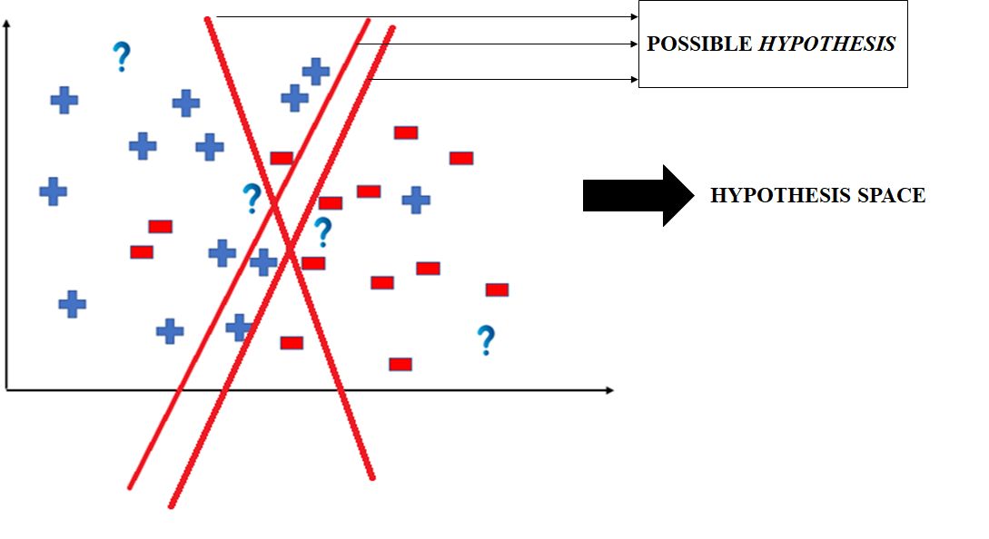
Hypothesis

Slide 41
Underfitting and Overfitting
Underfitting-Model is not able to obtain sufficiently low training error
Overfitting-The gap between training and test error is too large
We can control the overfitting /underfitting by altering its capacity
Set of functions the learning algorithm can select as being the solution

Slide 42
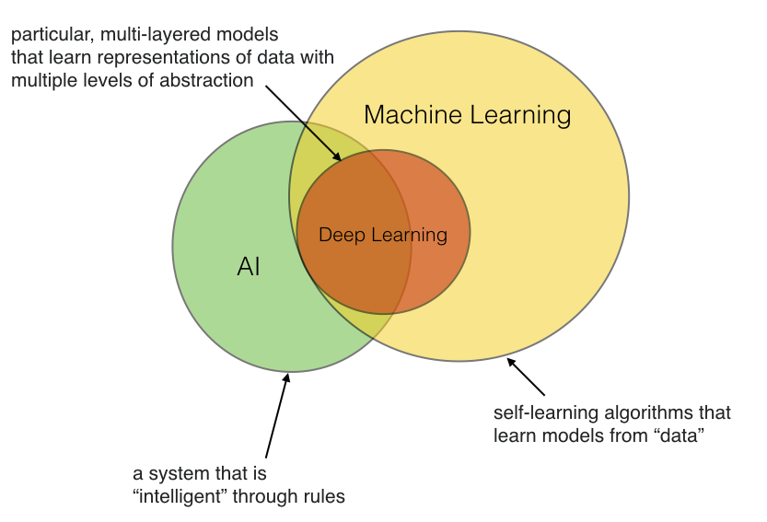
How are Artificial Intelligence and Machine Learning related?

Slide 43
How are Artificial Intelligence and Machine Learning related?
Artificial Intelligence (AI) started as a subfield of computer science with the focus on solving tasks that humans can but computers can’t do (for instance, image recognition). AI can be approached in many ways, for example, writing a computer program that implements a set of rules devised by domain experts. Now, hand-crafting rules can be very laborious and time consuming.
The field of machine learning – originally, we can consider it as a subfield of AI – was concerned with the development of algorithms so that computers can automatically learn (predictive) models from data.
For instance, say we want to develop a program that can recognize handwritten digits from images. One would be to look at all of these images and come-up with a set of (nested) if-this-than-that rules to say which image is displayed in a particular image (for instance, by looking at the relative locations of pixels). Another approach would be to use a machine learning algorithm, which can fit a predictive model based on a thousands of labeled image samples that we may have collected in a database. Now, there’s also deep learning, which in turn is a subfield of machine learning, referring to a particular subset of models that are particularly good at certain tasks such as image recognition and natural language processing.
Or in short, machine learning (and deep learning) definitely helps to develop “AI,” however, AI doesn’t necessarily have to be developed using machine learning – although, machine learning makes “AI” much more convenient ;).

Slide 44
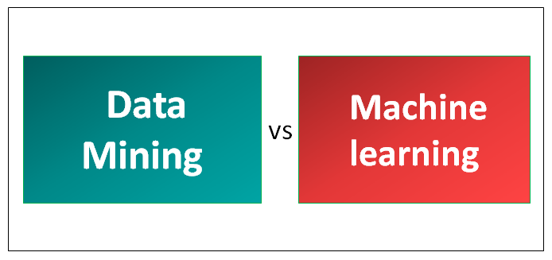
Machine Learning and Data Mining
Data mining focuses on the discovery of patterns in datasets or “gaining knowledge and insights” from data – often, this involves a heavy focus on computational techniques, working with databases, etc (nowdays, the term is more or less synonymous to “data science”). We can then think of machine learning algorithms as tools within a data mining project. Data mining is not “just” but also emphasis data processing, visualization, and tasks that are traditionally not categorized as “machine learning” (for example, association rule mining).

Slide 45
ML Terminology
▪
Training example: A row in the table representing the dataset. Synonymous to an observation, training record, training instance, training sample (in some contexts, sample refers to a collection of training examples)
▪
Feature: a column in the table representing the dataset. Synonymous to predictor, variable, input, attribute, covariate.
▪
Targets: What we want to predict. Synonymous to outcome, output, ground truth, response variable, dependent variable, (class) label (in classification).
▪
Output / prediction: use this to distinguish from targets; here, means output from the model.

Slide 46
THANK YOU

